Slide 1
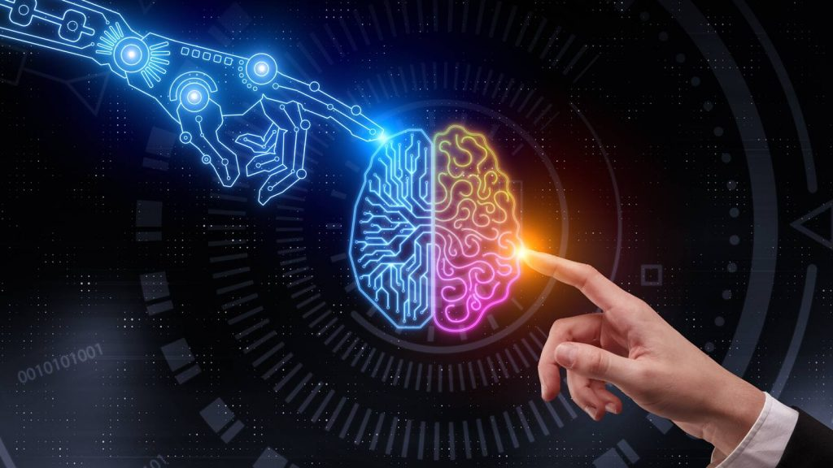
Artificial intelligence

Slide 2
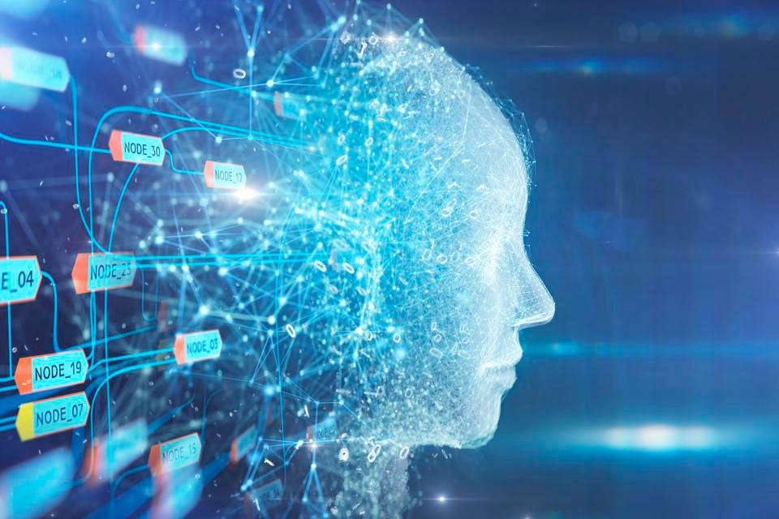
Chapter I
Introduction

Slide 3
1.1 What is Artificial Intelligence?
“Artificial intelligence is the simulation of human intelligence processes by machines, especially computer systems”.
Specific applications of AI include expert systems, natural language processing, speech recognition and machine vision.
Systems that think like humans
"The exciting new effort to make computers think . . . machines with minds, in the full and literal sense." (Haugeland, 1985) .
"The automation of activities that we associate with human thinking, activities such as decision-making, problem solving, learning . . ." (Bellman, 1978).
Systems that act like humans
"The art of creating machines that perform functions that require intelligence when performed by people." (Kurzweil, 1990).
"The study of how to make computers do things at which, at the moment, people are better." (Rich and Knight, 1991).

Slide 4
Systems that think rationally (based on reason or logic)
"The study of mental faculties through the use of computational models." (Chamiak and McDermott, 1985)
"The study of the computations that make it possible to perceive, reason, and act." (Winston, 1992).
Systems that act rationally
"Computational Intelligence is the study of the design of intelligent agents." (Pooleet al., 1998) .
"AI . . .is concerned with intelligent behavior in artifacts." (Nilsson, 1998).

Slide 5
Acting humanly: The Turing Test approach
The Turing Test, proposed by Alan Turing (1950), was designed to provide a satisfactory TURING TEST operational definition of intelligence.
A computer passes the test if a human interrogator, after posing some written questions, cannot tell whether the written responses come from a person or from a computer.
The computer would need to possess the following capabilities:
  Natural Language Processing to enable it to communicate successfully in English;
  Knowledge Representation to store what it knows or hears;
  Automated Reasoning to use the stored information to answer questions and to draw new conclusions;
  Machine Learning to adapt to new circumstances and to detect and extrapolate patterns.
The Total Turing Test includes a video signal so that the interrogator can test the subject’s perceptual abilities, as well as the opportunity for the interrogator to pass physical objects “through the hatch.”
To pass the total Turing Test, the computer will need
  Computer vision to perceive objects, and
  Robotics to manipulate objects and move about.

Slide 6
Thinking humanly: The cognitive modeling approach
If we are going to say that a given program thinks like a human, we must have some way of determining how humans think. We need to get inside the actual workings of human minds.
There are three ways to do this:
  through introspection — trying to catch our own thoughts as they go by;
  through psychological experiments — observing a person in action; and
  through brain imaging — observing the brain in action.
Once we have a sufficiently precise theory of the mind, it becomes possible to express the theory as a computer program.
If the program’s input–output behavior matches corresponding human behavior, that is evidence that some of the program’s mechanisms could also be operating in humans.

Slide 7
Thinking rationally: The “laws of thought” approach
There are two main obstacles to this approach.
First, it is not easy to take informal knowledge and state it in the formal terms required by logical notation, particularly when the knowledge is less than 100% certain.
Second, there is a big difference between solving a problem “in principle” and solving it in practice.
Even problems with just a few hundred facts can exhaust the computational resources of any computer unless it has some guidance as to which reasoning steps to try first.
Although both of these obstacles apply to any attempt to build computational reasoning systems, they appeared first in the logicist tradition.

Slide 8
Acting rationally: The rational agent approach
An agent is just something that acts (agent comes from the Latin agere, to do).
Of course, all computer programs do something, but computer agents are expected to do more: operate autonomously, perceive their environment, persist over a prolonged time period, adapt to change, and create and pursue goals.
A rational agent is one that acts so as to achieve the best outcome or, when there is uncertainty, the best expected outcome.
Knowledge representation and reasoning enable agents to reach good decisions.

Slide 9
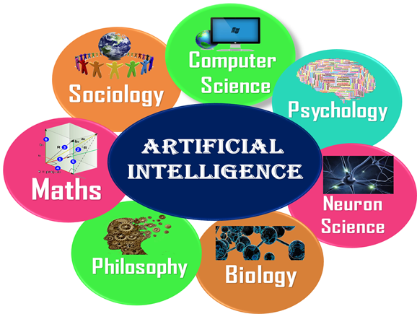
1.2 The Foundations of Artificial Intelligence
Commonly used AI techniques and theories are rule-based, fuzzy logic, neural networks, decision theory, statistics, probability theory, genetic algorithms, etc.
Since AI is interdisciplinary in nature, foundations of AI are in various fields such as
  Mathematics
  Neuroscience
  Control theory
  Linguistics
  Sociology
  Computer science
  Psychology

Slide 10
Mathematics:
AI systems use formal logical methods and Boolean logic (Boole, 1847), analysis of limits to what can be computed, probability theory, uncertainty that forms the basis for most modern approaches to AI, fuzzy logic, etc.
Neuroscience:
This science of medicine helps in studying the functioning of brains.
In early studies, injured and abnormal people were used to understand what parts of brain work. Now recent studies use accurate sensors to correlate brain activity to human thought.
By monitoring individual neurons, monkeys can now control a computer mouse using thought alone.
Moore's law states that the computers will have as many gates as humans have neurons in the year 2020.
Control theory:
Machines can modify their behavior in response to the environment (sense/ action loop).
Eg: Steam engine governor, thermostat and-water-flow regulator
In 1950, control theory could only describe linear systems. AI largely rose as a response to this shortcoming.

Slide 11
Linguistics
Speech demonstrates so much of human intelligence.
Analysis of human language reveals thought taking place in ways not understood in other settings. Children can create sentences they have never heard before.
Languages and thoughts are believed to be tightly intertwined.
Computer Engineering
How to build an efficient computer?
Provides the artifact that makes AI application possible
The power of computer makes computation of large and difficult problems more easily
AI has also contributed its own work to computer science, including: time-sharing, the linked list data type, etc.
Psychology
How do humans think and act?
The study of human reasoning and acting, provides reasoning models for AI.
Strengthen the ideas humans and other animals can be considered as information processing machines .

Slide 12
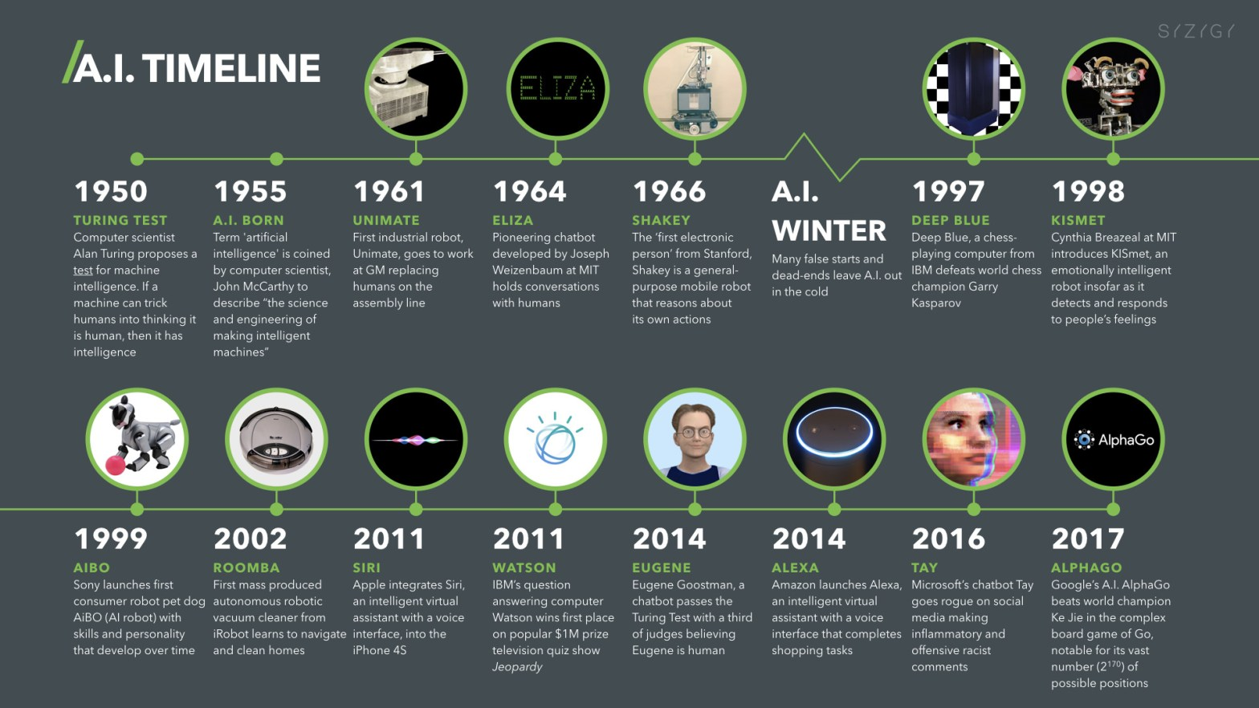
1.3 History of Artificial Intelligence
Following are some milestones in the history of AI.

Slide 13
Maturation of Artificial Intelligence (1943-1952)
Year 1943: The first work which is now recognized as AI was done by Warren McCulloch and Walter pits in 1943. They proposed a model of artificial neurons.
Year 1949: Donald Hebb demonstrated an updating rule for modifying the connection strength between neurons. His rule is now called Hebbian learning.
Year 1950: The Alan Turing who was an English mathematician and pioneered Machine learning in 1950. Alan Turing publishes "Computing Machinery and Intelligence" in which he proposed a test. The test can check the machine's ability to exhibit intelligent behavior equivalent to human intelligence, called a Turing test.
The birth of Artificial Intelligence (1952-1956)
Year 1955: Allen Newell and Herbert A. Simon created the "first artificial intelligence program “ Which was named as "Logic Theorist". This program had proved 38 of 52 Mathematics theorems, and find new and more elegant proofs for some theorems.
Year 1956: The word "Artificial Intelligence" first adopted by American Computer scientist John McCarthy at the Dartmouth Conference.
At that time high-level computer languages such as FORTRAN, LISP, or COBOL were invented. And the enthusiasm for AI was very high at that time.

Slide 14
The golden years-Early enthusiasm (1956-1974)
Year 1966: The researchers emphasized developing algorithms which can solve mathematical problems. Joseph Weizenbaum created the first chatbot in 1966, which was named as ELIZA.
Year 1972: The first intelligent humanoid robot was built in Japan which was named as WABOT-1.
The first AI winter (1974-1980)
The duration between years 1974 to 1980 was the first AI winter duration.
AI winter refers to the time period where computer scientist dealt with a severe shortage of funding from government for AI researches.
During AI winters, an interest of publicity on artificial intelligence was decreased.
Boom of AI (1980-1987)
Year 1980: After AI winter duration, AI came back with "Expert System". Expert systems were programmed that emulate the decision-making ability of a human expert.
In the Year 1980, the first national conference of the American Association of Artificial Intelligence was held at Stanford University.
For the first time, AI coined as an academic field.

Slide 15
The second AI winter (1987-1993)
The duration between the years 1987 to 1993 was the second AI Winter duration.
Again Investors and government stopped in funding for AI research as due to high cost but not efficient result.
The expert system such as XCON was very cost effective.
The emergence of intelligent agents (1993-2011)
Year 1997: In the year 1997, IBM Deep Blue beats world chess champion, Gary Kasparov, and became the first computer to beat a world chess champion.
Year 2002: for the first time, AI entered the home in the form of Roomba, a vacuum cleaner.
Year 2006: AI came in the Business world till the year 2006. Companies like Facebook, Twitter, and Netflix also started using AI.
Deep learning, big data and artificial general intelligence (2011-present)
Year 2011: In the year 2011, IBM's Watson won jeopardy, a quiz show, where it had to solve the complex questions as well as riddles. Watson had proved that it could understand natural language and can solve tricky questions quickly.
Year 2012: Google has launched an Android app feature "Google now", which was able to provide information to the user as a prediction.

Slide 16
Year 2014: In the year 2014, Chatbot "Eugene Goostman" won a competition in the infamous "Turing test."
Year 2018: The "Project Debater" from IBM debated on complex topics with two master debaters and also performed extremely well.
Google has demonstrated an AI program "Duplex" which was a virtual assistant and which had taken hairdresser appointment on call, and lady on other side didn't notice that she was talking with the machine.

Slide 17
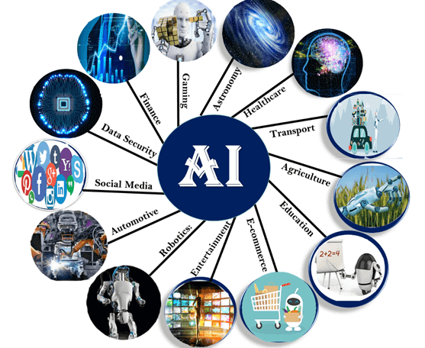
1.4 THE STATE OF THE ART
Following are some sectors which have the application of Artificial Intelligence:
1. AI in Astronomy
Artificial Intelligence can be very useful to solve complex universe problems.
AI technology can be helpful for understanding the universe such as how it works, origin, etc.
2. AI in Healthcare
Healthcare Industries are applying AI to make a better and faster diagnosis than humans.
AI can help doctors with diagnoses and can inform when patients are worsening so that medical help can reach to the patient before hospitalization.

Slide 18
3. AI in Gaming
The AI machines can play strategic games like chess, where the machine needs to think of a large number of possible places.
IBM’s DEEP BLUE became the first computer program to defeat the world champion in a chess match when it bested Garry Kasparov by a score of 3.5 to 2.5 in an exhibition match (Goodman and Keene, 1997).
4. AI in Finance
The finance industry is implementing automation, chatbot, adaptive intelligence, algorithm trading, and machine learning into financial processes.
5. AI in Data Security
Cyber-attacks are growing very rapidly in the digital world. AI can be used to make the data more safe and secure.
Some examples such as AEG bot, AI2 Platform, are used to determine software bug and cyber-attacks in a better way.
6. AI in Social Media
Social Media sites such as Facebook, Twitter, and Snapchat contain billions of user profiles, which need to be stored and managed in a very efficient way.
AI can organize and manage massive amounts of data. AI can analyze lots of data to identify the latest trends, hashtag, and requirement of different users.

Slide 19
8. AI in Automotive Industry
Some Automotive industries are using AI to provide virtual assistant to their user for better performance. Such as Tesla has introduced TeslaBot, an intelligent virtual assistant.
Various Industries are currently working for developing self-driven cars which can make the journey more safe and secure.
9. AI in Robotics:
Usually, general robots are programmed such that they can perform some repetitive task, but with the help of AI, we can create intelligent robots which can perform tasks with their own experiences without pre-programmed.
Humanoid Robots are best examples for AI in robotics, recently the intelligent Humanoid robot named as Erica and Sophia has been developed which can talk and behave like humans.
The iRobot Corporation has sold over two million Roomba robotic vacuum cleaners for home use.
10. AI in Entertainment
We are currently using some AI based applications in our daily life with some entertainment services such as Netflix or Amazon. With the help of ML/AI algorithms, these services show the recommendations for programs or shows.
11. AI in Agriculture
Agriculture is an area which requires various resources, labor, money, and time for best result. Now a day's agriculture is becoming digital, and AI is emerging in this field.

Slide 20
Agriculture is applying AI as agriculture robotics, solid and crop monitoring, predictive analysis.
12. AI in E-commerce
AI is helping shoppers to discover associated products with recommended size, color, or even brand.
13. AI in education:
AI can automate grading so that the tutor can have more time to teach. AI chatbot can communicate with students as a teaching assistant.
AI in the future can be work as a personal virtual tutor for students, which will be accessible easily at any time and any place.
14. Spam fighting:
Each day, learning algorithms classify over a billion messages as spam, saving the recipient from having to waste time deleting what, for many users, could comprise 80% or 90% of all messages, if not classified away by algorithms.
Because the spammers are continually updating their tactics, it is difficult for a static programmed approach to keep up, and learning algorithms work best (Sahami et al., 1998; Goodman and Heckerman, 2004).
15.Machine Translation
A computer program automatically translates from Arabic to English, allowing an English speaker to see the headline “Ardogan Confirms That Turkey Would Not Accept Any Pressure, Urging Them to Recognize Cyprus.”

